Slide 1
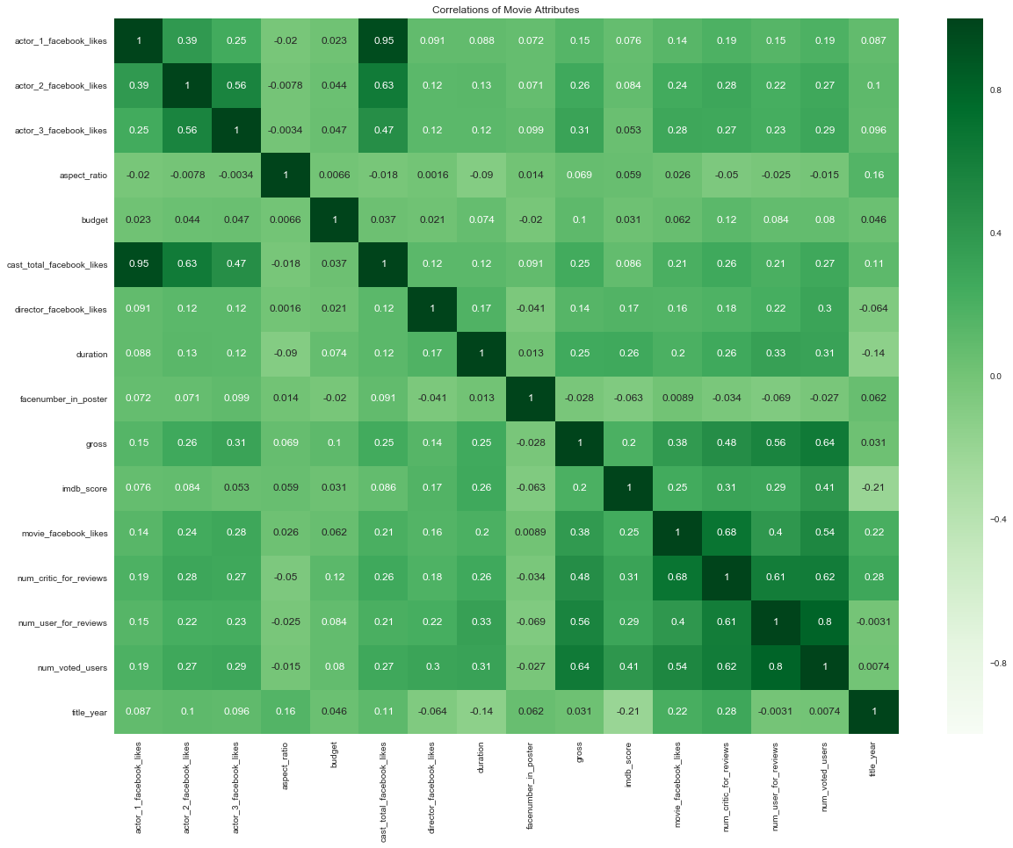
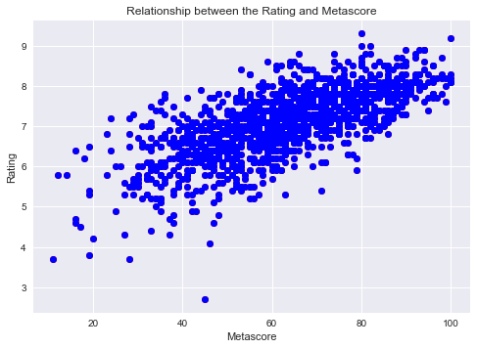
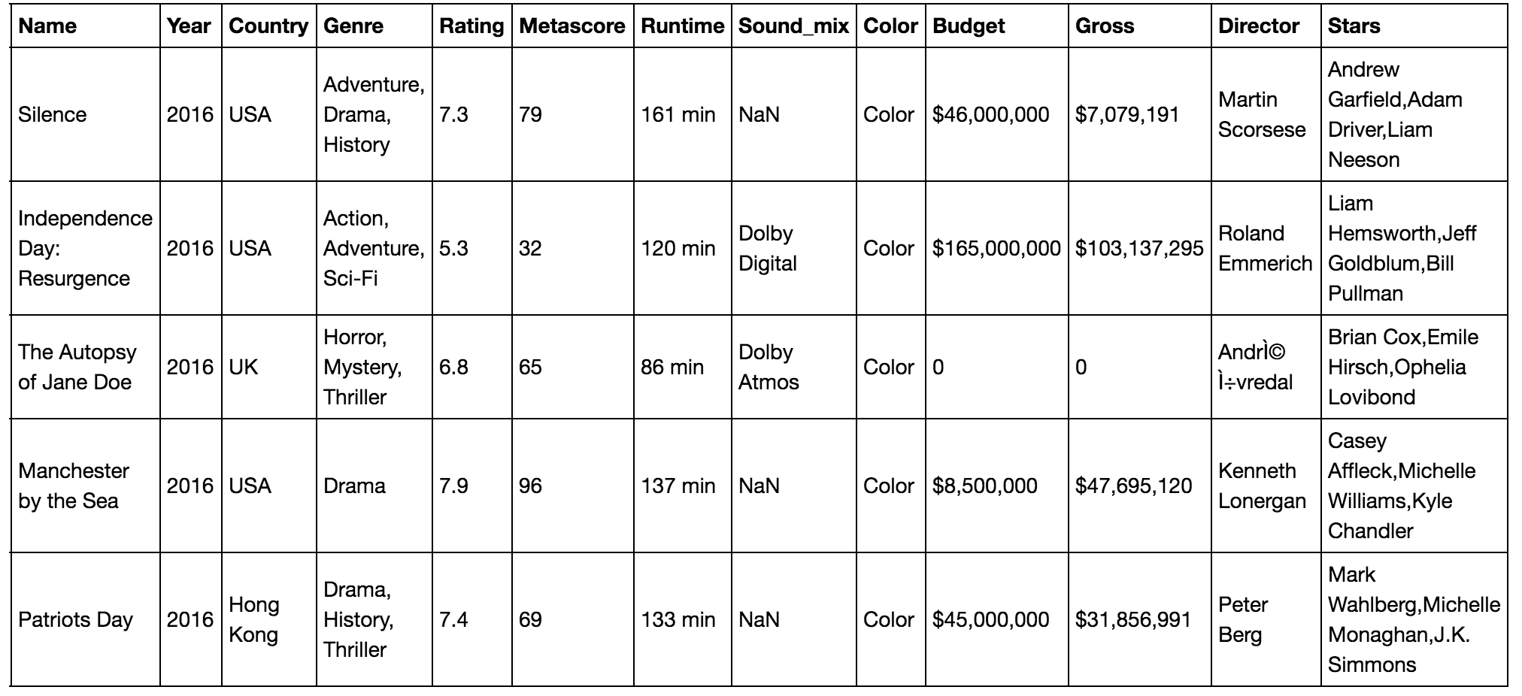
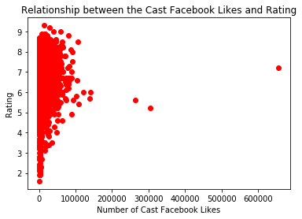
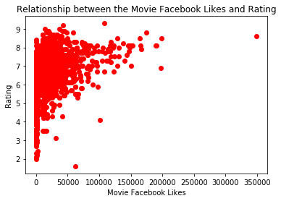
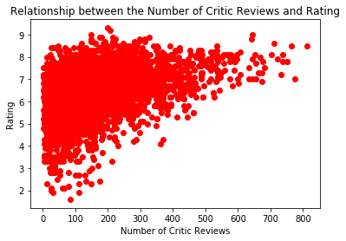
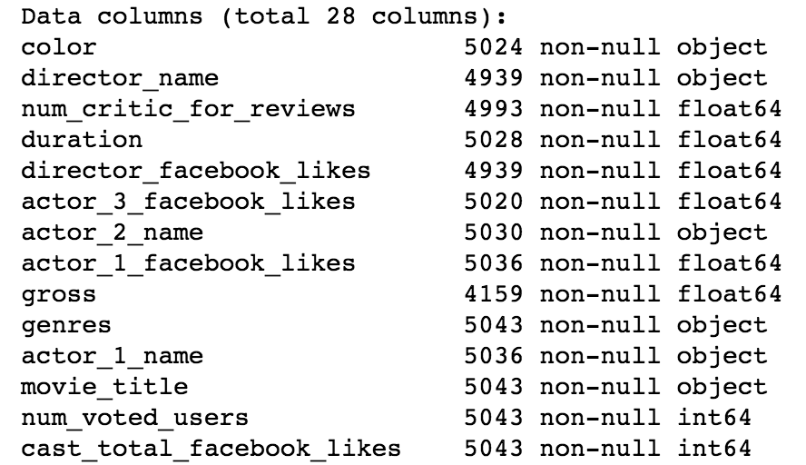
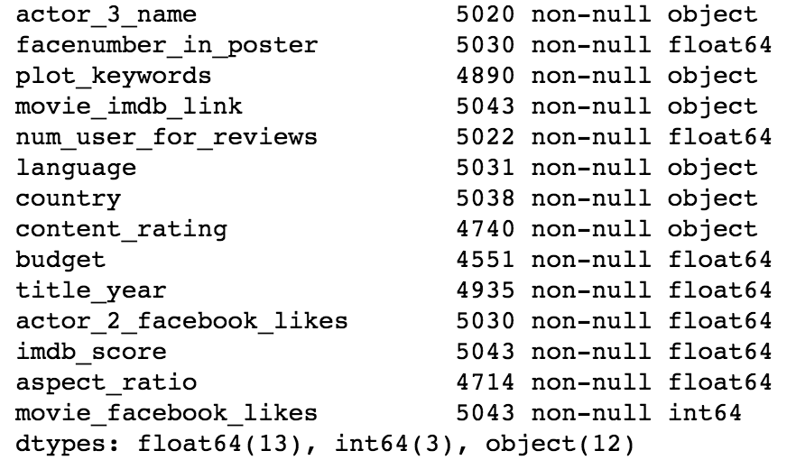


bu.edu/cs
Film Rating Prediction:
A Survey on SVM, Decision Tree and KNN Classifiers
Instructors: Evimaria Terzi, Sanaz Bahargam
Students: Fan Li, Duomin Ji
Background
Machine Learning has always been a big topic these years. It explores the study of algorithms that enables computers to ‘learn’ and make predictions on the data. In this survey, our team focuses on the study of three different models through which the computer would ‘learn’ how to predict a film’s rating based on some other supporting information of the film, such as film gross and the Facebook likes of the leading actors.
Problems
Best Rating-related Attributes: given a set of features of the film, find out the ones that would help the computer predict the film’s rating accurately.
Datasets
Dataset 1¹:
Scraped by our team from www.imdb.com, it consists of information of over 5,500 popular films throughout the years from 1898 to 2016.
Dataset 2²:
A more diverse dataset containing extra information of over 5,000 films (most are different films from films in dataset 1).
Experiments
We used dataset-1 in Experiment 1 and dataset-2 in E2, E3 and E4. The datasets were both split into training data (80%) and testing data (20%).
Experiment 1: Predict film ratings (IMDB users’ ratings) based merely on Metascores (critics’ ratings).
Experiment 2: Predict film ratings based on multiple attributes, including the number of Facebook likes of leading actors, the number of reviews, etc., which we thought would have helped the most.
Experiment 3: Predict film ratings based on multiple attributes which have the strongest Pearson Correlation with the rating. We would also exclude the attributes having little or no effects on the predictions to avoid possible overfitting problem.
Experiment 4: Instead of predicting film ratings, we would classify films into ‘great’ or ‘bad’ films based on the ratings of 25 and 75 percentiles.
Model | Accuracy
SVM | 0.362089914945
Decision Tree | 0.400972053463
KNN | 0.3304981774
Observations: as opposed to our initial assumption, actors’ social media popularity does not have large impact on how people would rate their films. More surprisingly, the film’s duration has a very strong correlation with the film rating! Using features as such, we improved the accuracies.
Model | Accuracy
SVM | 0.0327272727273
Decision Tree | 0.0218181818182
KNN | 0.00727272727273
Observations: Though the Pearson Correlation suggests a positive correlation between the two, the accuracies are all pretty low. The critics’ rating on a film is important but not decisive. There are many factors that could have effects on the film’s rating.
Observations: predicting film ratings on a scale of 1-10 is a really hard task for the classifiers with limited data. And it is expected that all three models would have higher accuracies if they were to classify only two categories.
Model | Accuracy
SVM | 0.645454545455
Decision Tree | 0.881818181818
KNN | 0.718181818182
Conclusion:
The data attributes with higher correlations to the target feature tend to give us better prediction accuracies.
Relatively more attributes would offer better predictions.
The Decision Tree Classifier performed best and possible reasons include: all-numerical-value dataset, small dataset size and data non-linearity.
Future Work:
Expanding the dataset both vertically and horizontally
Experimenting with more models and classifiers
Identifying appropriate combination of supporting vectors (film features) that predicts most accurately.
Observations: Our models performed better than they did in Exp1. We were not sure, however, what the most influential attributes are and how well they would help the models learn.
Model | Accuracy
SVM | 0.356881851401
Decision Tree | 0.390986601705
KNN | 0.3215590743
References and Sources:
1. Films in this dataset (films.csv) are scraped from www.imdb.com . The dataset is used only in this study and will not be used for commercial purposes.
2. The www.kaggle.com provides this public data (movie_metadata.csv) for academic use only.
@BUCompSci

